Slide 1
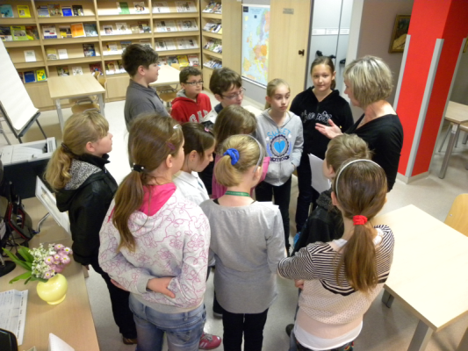
The latest tendencies in intergenerational learning
Stowarzyszenie Kulturalno-Oświatowe LIBRI
Tarnobrzeg, Poland

Slide 2
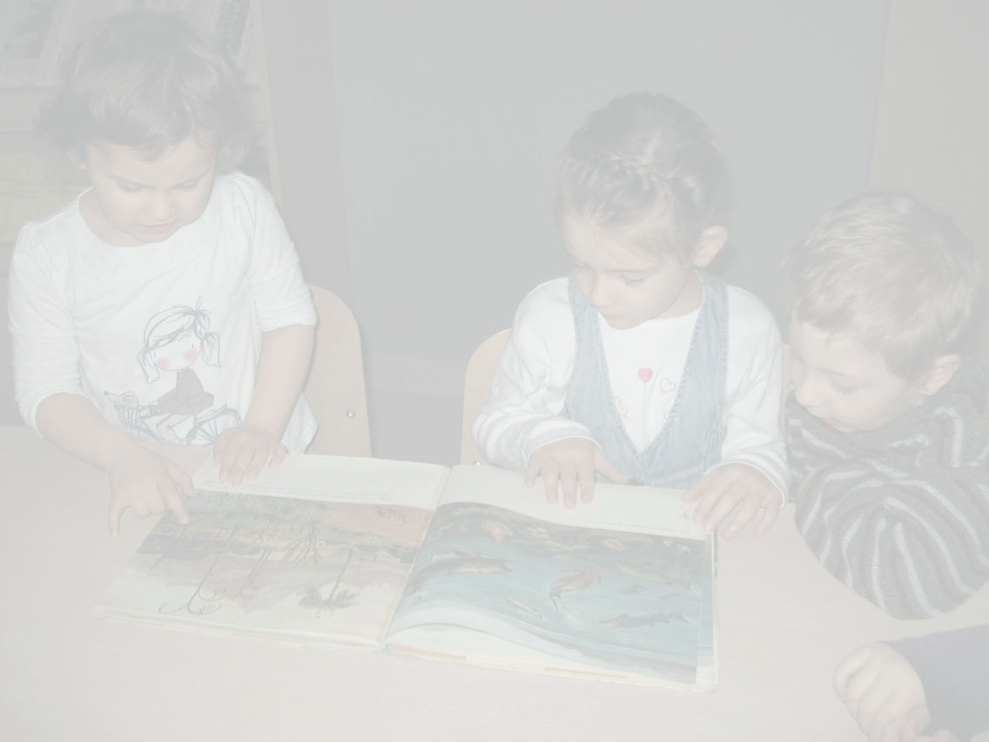
More and more parents in Poland choose to home-school their children
The reason is their dissatisfaction with the educational system in schools.
Home schooling is done at home, but it can also take place in other locations: museums, theatres, libraries. Usually the children are taught by their parents, but also other family members get involved, as well as professional teachers.

Slide 3
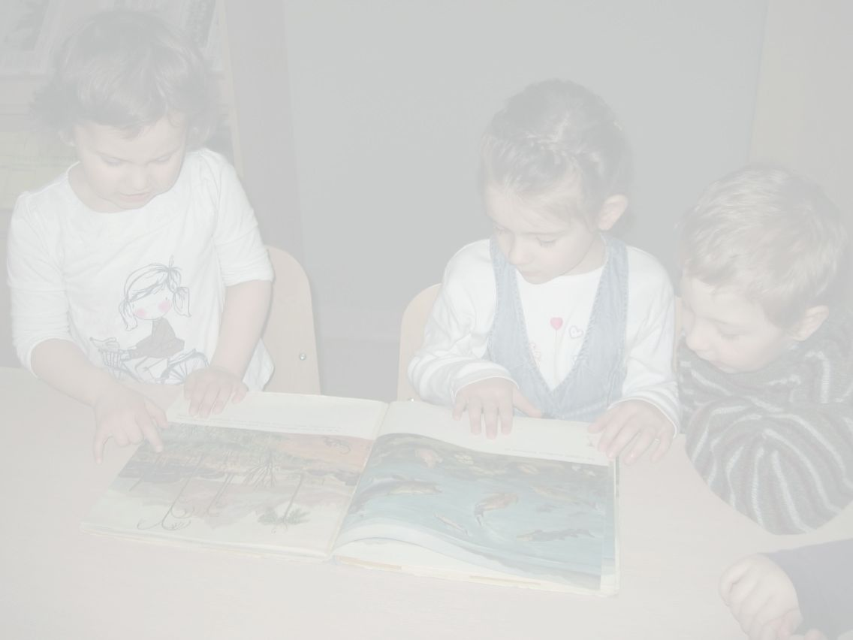
Parents who choose home schooling state that it is due to the fact that by nature, the parent is the first and the best educator for their child.
Familiar environment makes the education much more comfortable for the child. Learning is more effective, no time is wasted on enforcing discipline in class, taking attendance or similar organisational activities that usually take place in regular school.
The child is able to learn anything he or she is interested in, at the most individually optimal pace.

Slide 4
Not every parent feels capable of teaching their own child
You don’t need to be a certified educator, though! According to an American study, the level of formal education of the parents who home school their children has no relation with their children’s exam results.
Children of parents with a high school diploma achieve similar results to children of parents with a PhD.

Slide 5
It may seem difficult to switch from the role of a parent into that of a teacher
But the parent also instructs and demands from the child on a daily basis. It's a matter of mutual respect and negotiation.
There is also the idea of unschooling, where the child is left to pursue its own interests and is only given support when he or she signals a need for that. Research shows that such unschooled children achieve the same results as children home schooled under supervision on a daily basis.

Slide 6
The American research of home schooling was conducted by Lawrence Rudner in 1998
Results:
On average, a homeschooled 14-year-old is on the educatioal level of 4 grades higher than a 14-year-old taught in a different system.
Homeschooled children are more likely to get invovled in social activities such as sports clubs, orchestras, scouts, religious groups, volunteering

Slide 7
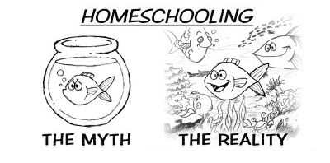
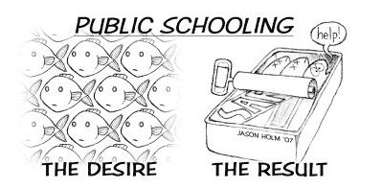
Homeschooling also strengthens the bonds of the whole family
Parents as educators need, however, to be aware of different stages of development of the child.

Slide 8
Not all parents understand how important playing is for children's development
Playing stimulates the physical, social and emotional development at the early stages of life.
So, children need time, space, materials and competent educators particularly in their early years.

Slide 9
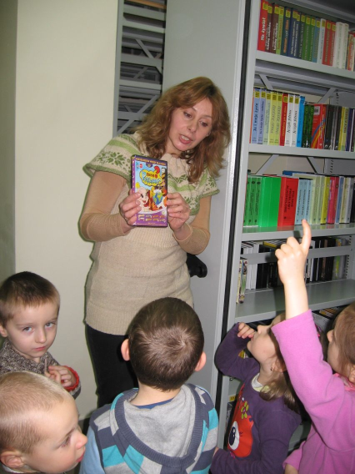
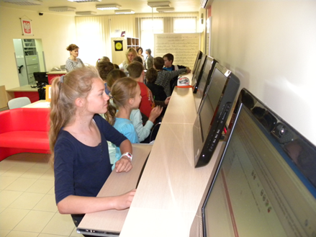
Playing helps development and consequently, it leads to education
It's not just about education, though
Teaching in the library

Slide 10
Children need time for playing for the sake of playing
If the playing always serves only education purposes devised by adults, it is no longer fun from the child's perspective. It becomes work.
A competent teacher is someone who gives children an opportunity to play and helps them become more skillful.

Slide 11
Chidren need the support of adults, who can do the following:
give the children long, uninterrupted periods of time (at least 45-60 minutes) for spontaneous play, not controlled by the adults
provide them with various materials that make different sorts of games possible
acknowledge that children need challenges while playing
make sure that all children present have the opportunity to be involved
let children play in a way that makes children's own ideas come true
play with chidren on the children's terms, be interested in their ideas

Slide 12
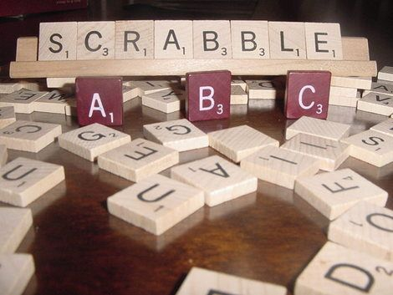
One of the tendencies in educating children is gamification
If learning seems like a game, the students are more involved.
Gamification employs all sorts of mechanisms that result in children gaining knowledge in a way which is pleasant and fun for them.

Slide 13
School has nearly all the necessary features to seem like a game:
There is rivalry, randomness, role-playing, strong emotions, curiosity and rewards.
The only missing piece is the independence of the player, seeing as school is obligatory

Slide 14
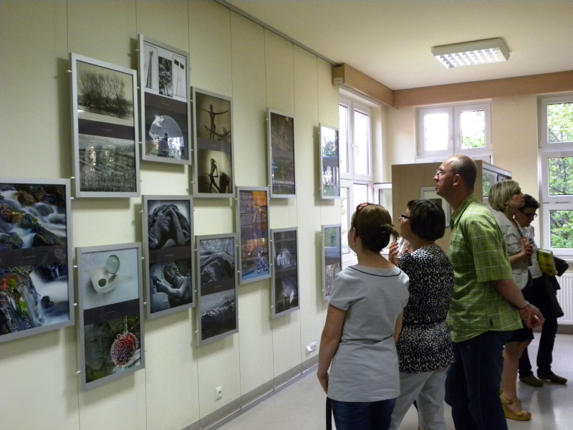
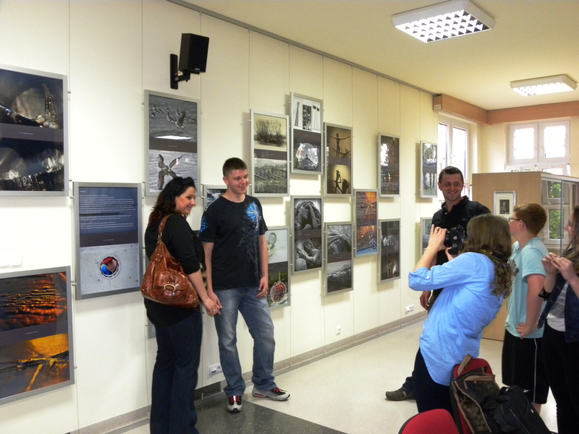
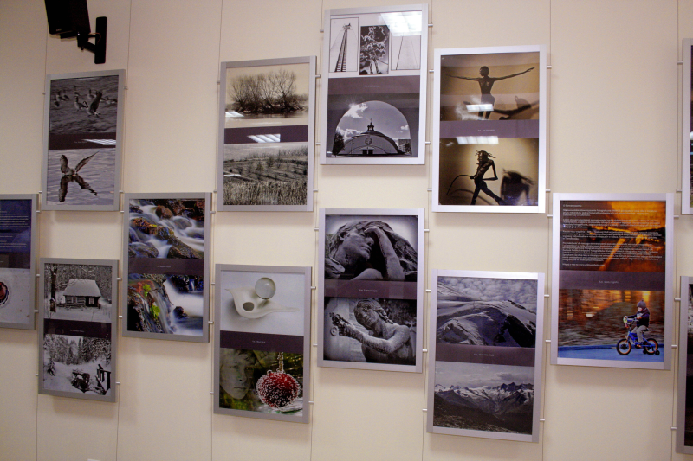
Photography workshops – learning techniques of taking photos

Slide 15
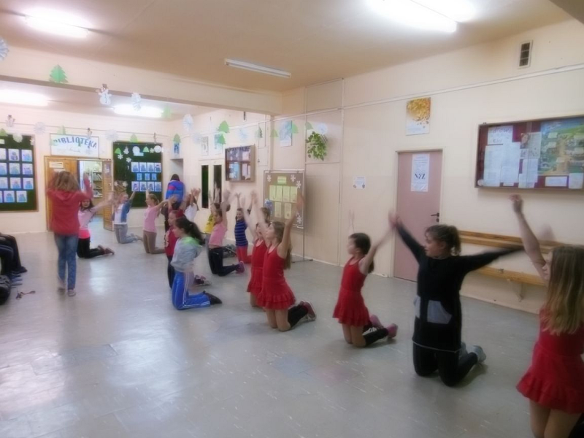
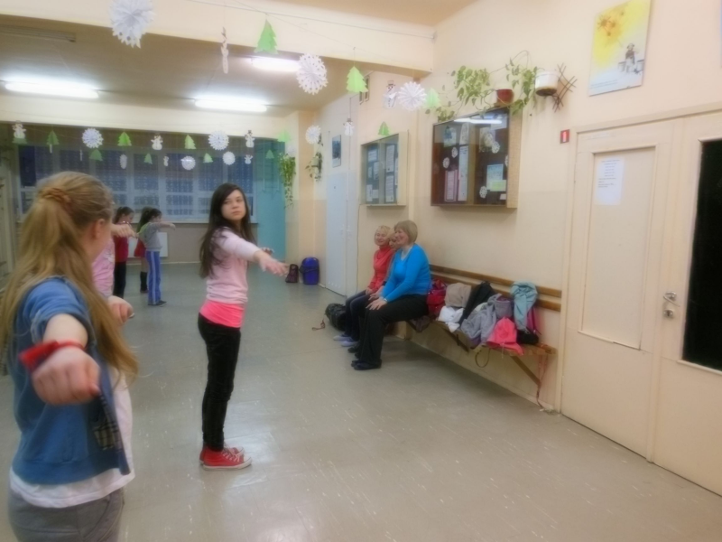
Dance workshop

Slide 16
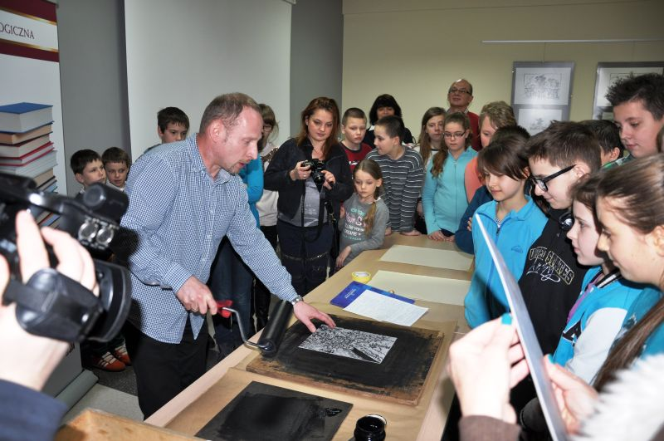
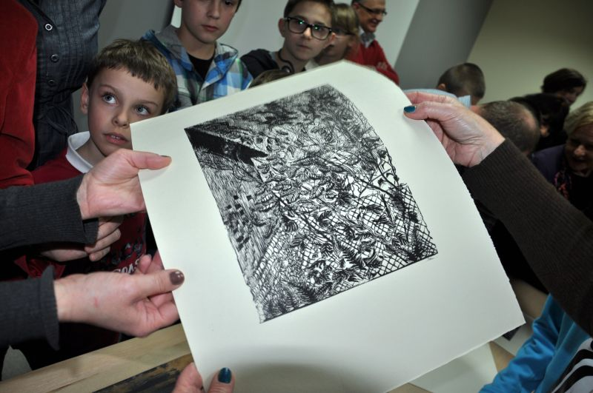
Exhibition and presentation of linocut prints

Slide 17
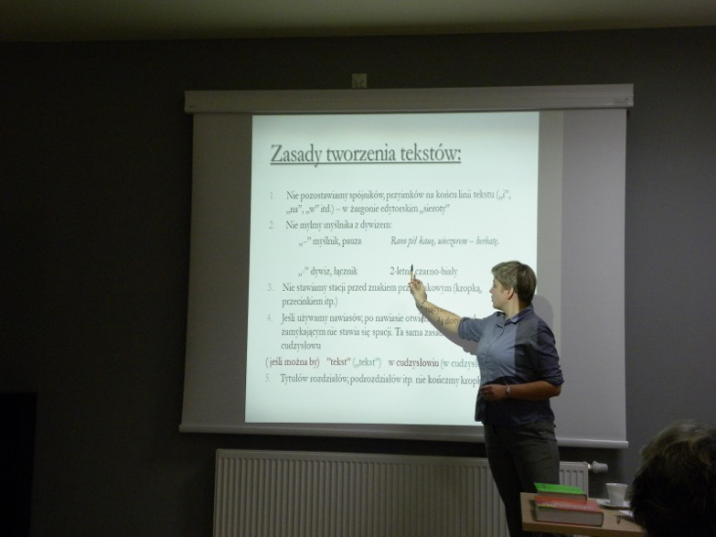
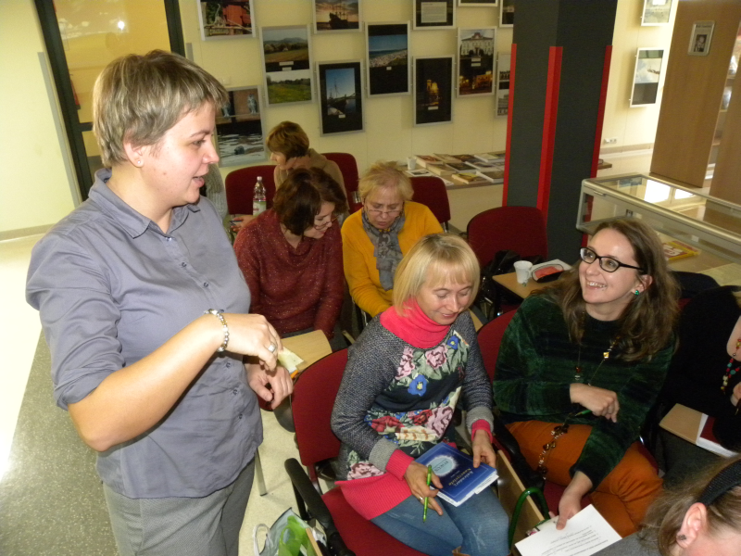
Linguistic workshop – how to speak proper language and avoid common mistakes

